Slide 1
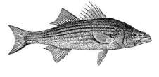
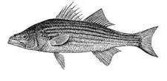
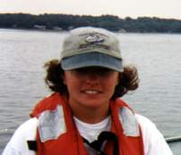
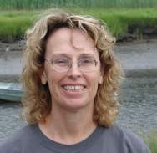
Striper Prey and Salinity
By Liz Duff
Mass Audubon
Special thanks to Kristen Ferry and Martha Mather for their Striped Bass Research as part of
Plum Island Ecosystems Long Term Ecological Research (PIE-LTER)
Kristen Ferry
Martha Mather
1
http://pie-lter.ecosystems.mbl.edu/content/striped-bass-curriculum

Slide 2
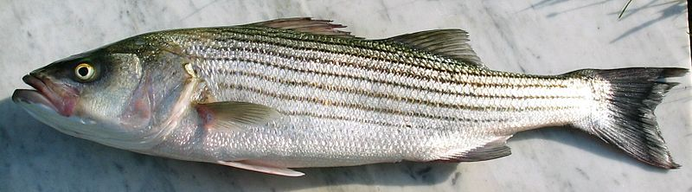
Many people are interested in striped bass, and have worked to support the survival of this species.
Many fish populations are in decline due to overfishing.
2

Slide 3
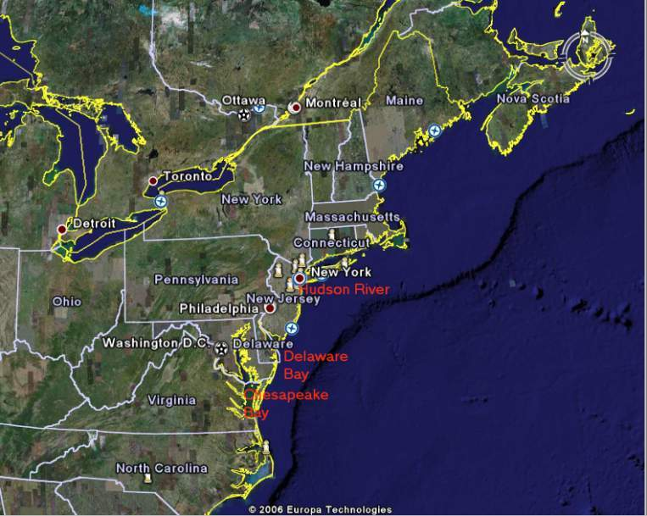
Striped bass spawn in the Chesapeake Bay, Delaware Bay, and in the Hudson River.
3
Notes:
If you live somewhere on the map, point out where your classroom is located.

Slide 4
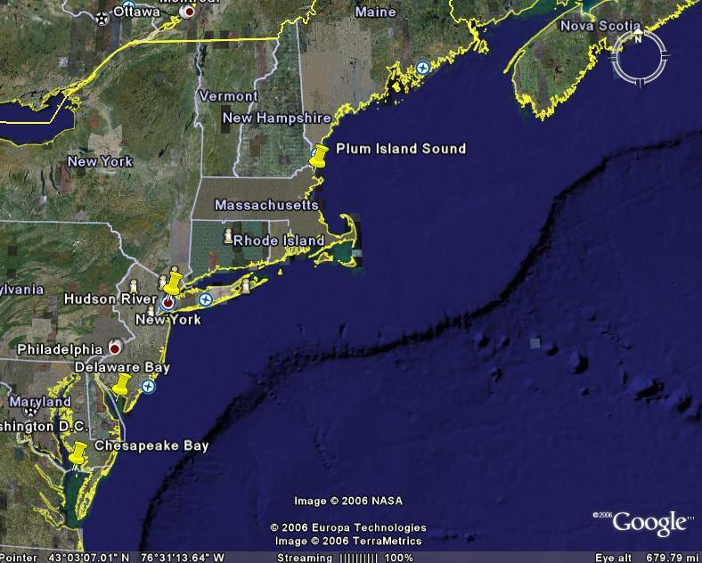
Many striped bass migrate north in the spring to feed. Many of the young bass, called “schoolies” travel to the estuary in Plum Island Sound, on the north coast of Massachusetts to feed.
4

Slide 5
Striped Bass
Migration Routes
= Spring
= Summer
= Fall
Boston
(Specific return route is unknown)
= Winter
Hudson
*
Delaware
*
Chesapeake
*
MDMF 1998
People think that coastal bass migrate north to feed. Not every bass makes this journey.
5

Slide 6
Thought Question
Why would the striped bass make this journey north?
Why do they return south?
6
Notes:
(Answer: following their food source. Salinity tolerances of the striped bass’ prey plays a key role)

Slide 7
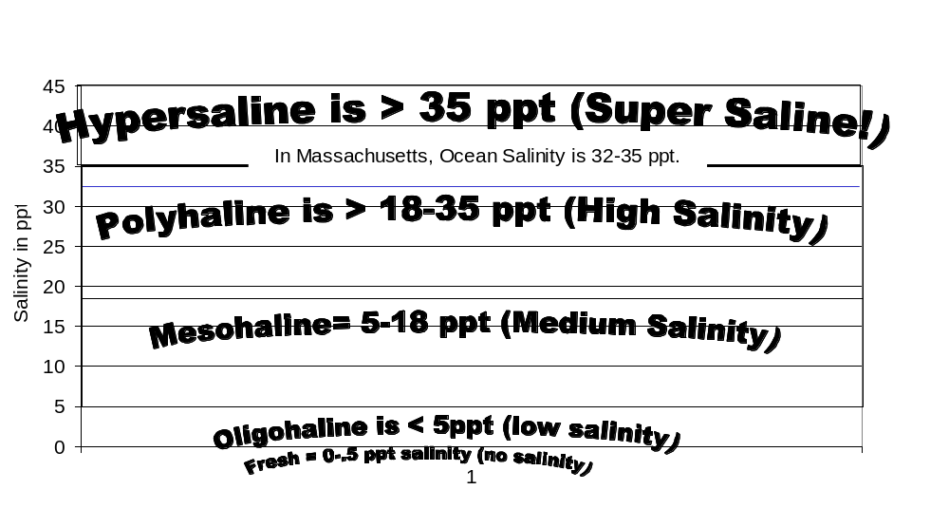
“Salinity” is how salty the water is.
It ranges from 0 ppt (fresh) in lakes and rivers to 32-37 ppt in the ocean.
7

Slide 8
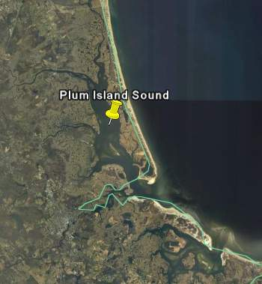
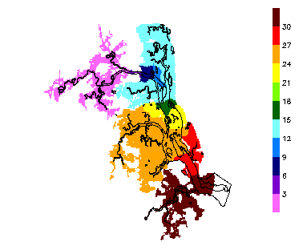
Striped bass can survive in a wide range of salinities. (0-30 ppt) They can live throughout Plum Island Sound.
Question: Will salinity affect the location of their prey species?
Hypothesis: The distribution of striped bass will be impacted by the distribution of their prey. If salinity impacts the distribution of the striped bass prey, it will impact the distribution of the striped bass. http://ecosystems.mbl.edu/pie/over.htm
8

Slide 9




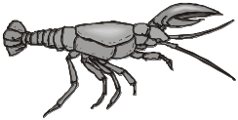
“Schoolie” striped bass in Massachusetts’ estuaries eat a variety of food.
4
3
2
1
Mummichog
Silverside
River
herring
Sand
lance
Crabs
Shrimp
Lobster ???
Menhaden
What range of salinities can these organisms tolerate?
9
Ferry & Mather
Notes:
Schoolie” is a term used for smaller striped bass, not large enough to keep legally.
They are often seen in schools. 3-5 years old.
Mummichog and silverside images are from http://www.gma.org/fogm/Default.htm
Fishes of the Gulf of Maine
By Henry B. Bigelow and William C. Schroeder

Slide 10
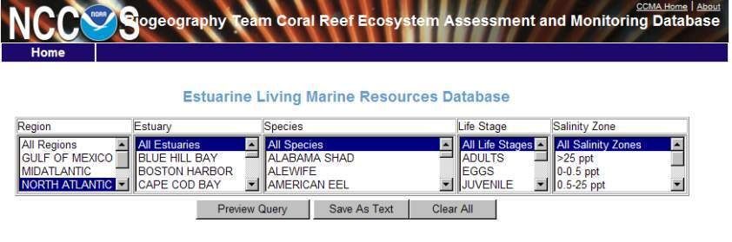
Comparing Salinity Tolerance of
Schoolie Prey Adults vs. Eggs On-Line.
Check ELMR Estuarine Living Marine Resources web-site
http://www8.nos.noaa.gov/biogeo_public/elmr.aspx
Click on “North Atlantic” and choose the estuary and species you want. Click on the different salinity zones for each species. For fish, check adult and eggs. For other species, such as crabs, just check adult. If it shows numbers other than zeros, it is present. If all zeros, it is not.
If you would like to bypass using the ELMR database, skip to slide 15
10

Slide 11
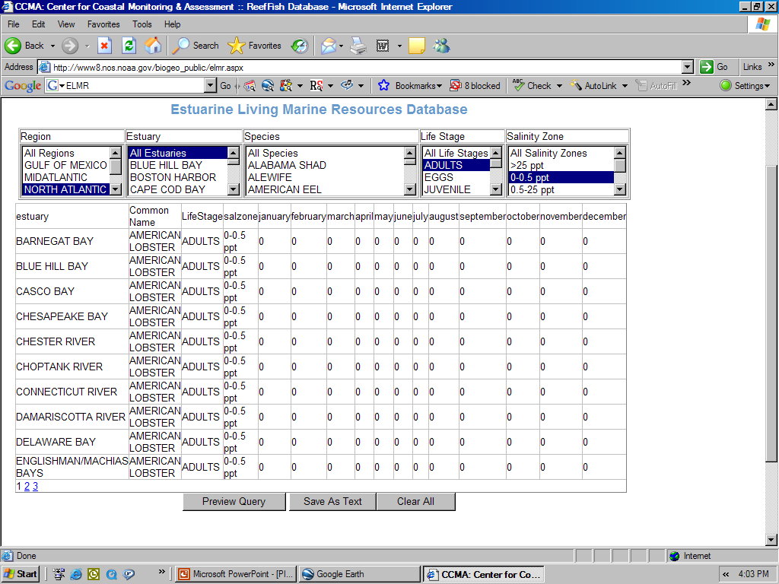
Example: There are zero adult lobsters at 0-0.5 ppt salinity.
11

Slide 12
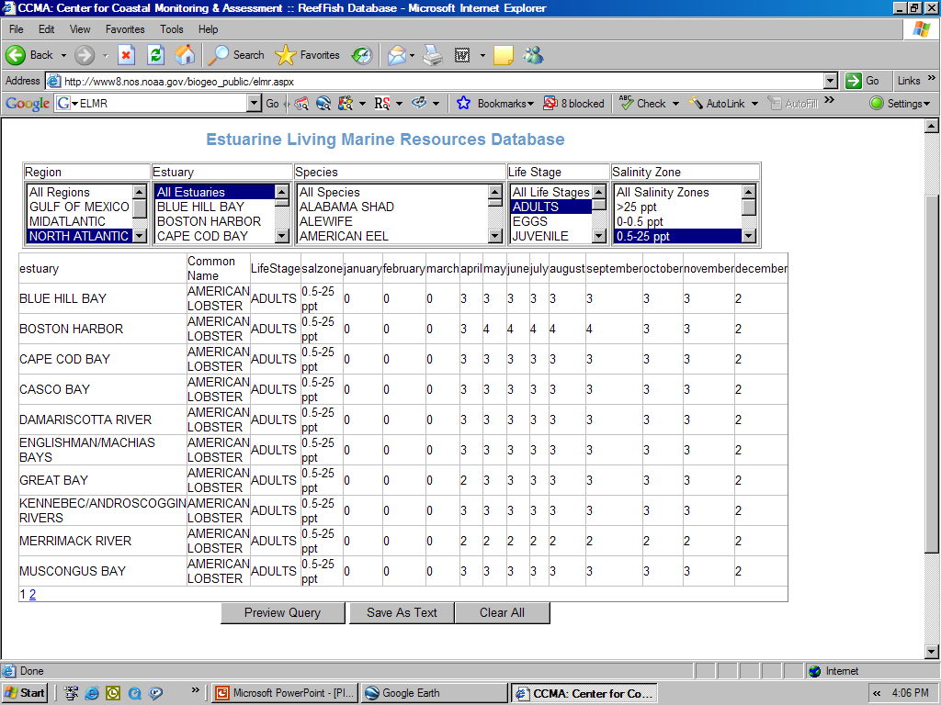
Adult lobsters can be found at .5-25 ppt in the months
of April through December.
12

Slide 13
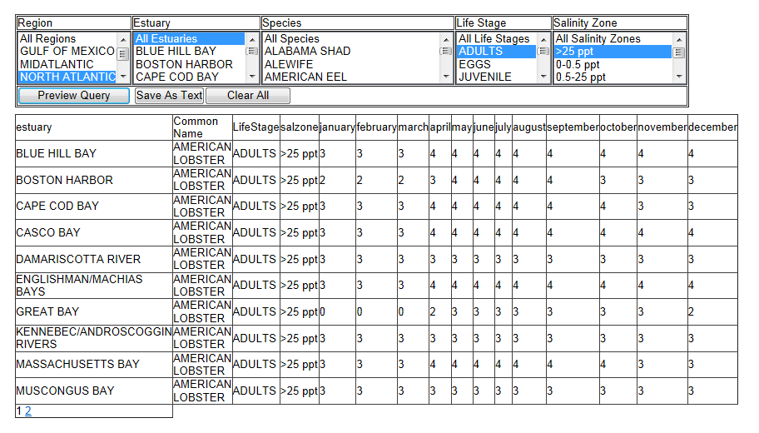
Adult lobsters can be found a > 25 ppt in every month.

Slide 14
Adults
Write Yes or No to indicate if these species can tolerate the following salinities. What numbers are present
Striper Prey Salinity Tolerances
Prey Species | Fresh | .5-25 | >25
Alewife
American Sand Lance
American Lobster | No | Yes- RARE | Yes (3,4)
Blueback Herring
(Daggerblade) Grass Shrimp
Green Crab
Atlantic Menhaden
Mummichog
Sevenspine Bay Shrimp (Sand Shrimp)
Silversides
13
Notes:
Check ELMR Estuarine Living Marine Resources web-site

Slide 15
Striper Prey Salinity Tolerances- Eggs
Write Yes or No to indicate if these species eggs can tolerate the following salinities
Eggs
Prey Species | Fresh | .5-25 | >25
Alewife
American Lobster
American Sand Lance
Blueback Herring
Atlantic Menhaden
Mummichog
Silversides
What other questions can this data base help you answer? In your science journal, or on the back of this paper, list your questions. Choose one and investigate. Write down your question and its answer.
14

Slide 16
Pause for the Activity
18

Slide 17
Adults
Write Yes or No to indicate if these species can tolerate the following salinities
Striper Prey Salinity Tolerances
Prey Species | Fresh | .5-25 | >25
Alewife | Yes | Yes | Yes
American Sand Lance | No | Yes- RARE | Yes
American Lobster | Yes | Yes | Yes
Blueback Herring | Yes | Yes | Yes
(Daggerblade) Grass Shrimp | No | Yes | Yes
Green Crab | No | Yes | Yes
Atlantic Menhaden | No | Yes | Yes
Mummichog | Yes | Yes | Yes
Sevenspine Bay Shrimp (Sand Shrimp) | Yes | Yes | Yes
Silversides | No | Yes | Yes
13
Notes:
Check ELMR Estuarine Living Marine Resources web-site

Slide 18
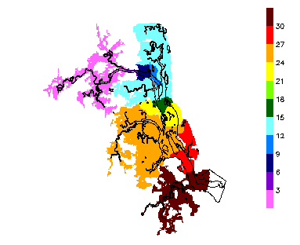
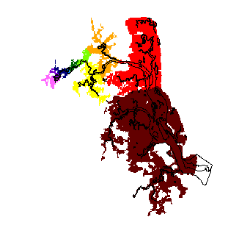
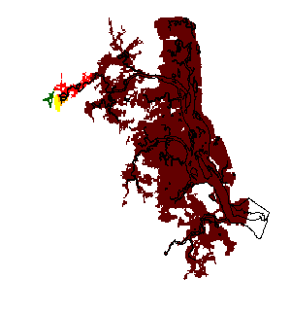
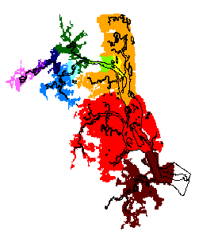
Plum Island Sound –
Seasonal Salinity Map
Based on the ELMR data, Where do you think the greatest abundance of schoolie prey will be found?
Spring
(April 15, 1987)
Summer
(June 17, 1987)
Design symbols to represent schoolie prey and put them on your maps.
Fall
(September 17, 1987)
Winter
January 7, 1987
http://ecosystems.mbl.edu/pie/over.html
16

Slide 19
Discussion
What organisms cannot live in fresh water when they are adults?
Look at the map of seasonal changes in Plum Island Sound.
How might the change in seasons affect the distribution of prey, and therefore striped bass?
19
Notes:
(Answer: Lobster (8-36), menhaden (10-36) and sand lance (26-36) cannot go everywhere in PIS. Highest salinity in the fall and summer. Organisms with a low salinity tolerance will not be as abundant during these seasons)

Slide 20
Discussion
What organisms cannot live in fresh water when they are adults?
American lobster, Atlantic menhaden, and American Sand Lance are not found in fresh water. Lobster and sand lance are rare except in > 25 high salinity areas.
How might the change in seasons affect the distribution of prey, and therefore striped bass?
If striped bass prefer those prey species, it might affect its distribution.
19
Notes:
(Answer: Lobster (8-36), menhaden (10-36) and sand lance (26-36) cannot go everywhere in PIS. Highest salinity in the fall and summer. Organisms with a low salinity tolerance will not be as abundant during these seasons)

Slide 21
Salinity Distributions – Plum Island Sound
Answers
Sand lance is rare except in high salinity areas. All other species are found in all salinities.
Sand
Lance
Spring
(April 15, 1987)
Summer
(June 17, 1987)
Their ranges in PIS increases in the summer and fall. Do you think this helps the striped bass? Show the summer and fall range for the sand lance.
Fall
(September 17, 1987)
Winter
January 7, 1987
The sand lance can tolerate salinities in
the orange red and brown areas. The brown area expands greatly in the summer and fall.
http://ecosystems.mbl.edu/pie/over.htm
21

Slide 22
Answers for Eggs
Eggs
Prey Species | Fresh | .5-25 | >25
Alewife | Yes | Yes | No
American Lobster | No | No | Yes
American Sand Lance | No | Yes - Rare | Yes
Blueback Herring | Yes | Yes | No
Atlantic Menhaden | No | No | Yes
Mummichog | Yes | Yes | Yes
Silversides | Yes | Yes | Yes
What other questions can this data base help you answer? In your science journal, or on the back of this paper, list your questions. Choose one and investigate. Write down your question and its answer.
14

